Slide 1
NASA UPDATES and more
NASA after the Space Shuttle
Dr. Carl J. Wenning
Physics Department
Illinois State University
Normal, Illinois USA

Slide 2
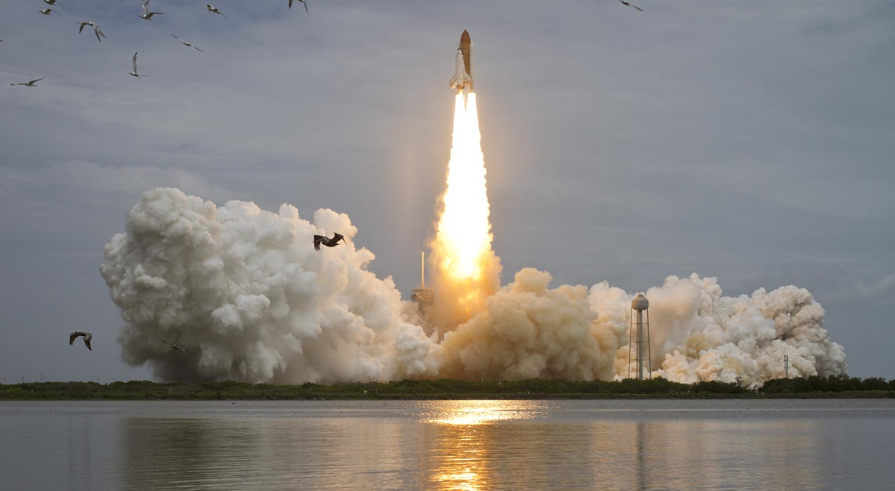
End of the space shuttle era…

Slide 3
The Space Shuttle
135 missions from 1981 – 2011
“Reusable” design
5 orbiters
Enterprise (prototype)
Columbia (1981) – 28 missions
Challenger (1983) – 10 missions
Discovery (1984) – 39 missions
Atlantis (1985) – 33 missions
Endeavor (1992) – 25 missions
Notes:
The Shuttle program at a glance

Slide 4
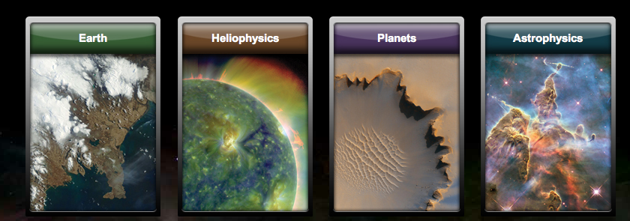
Nasa – areas of ongoing research
Science Mission Directorate (http://nasascience.nasa.gov/)
Seek new knowledge and understanding of our planet Earth, our Sun and solar system, and the universe.
Mission to Planet Earth
Heliophysics
Exploring the Solar System
Astrophysics
Notes:
NASA’s Science Mission Directorate is the perfect way to share current, high-profile developments in space science.

Slide 5
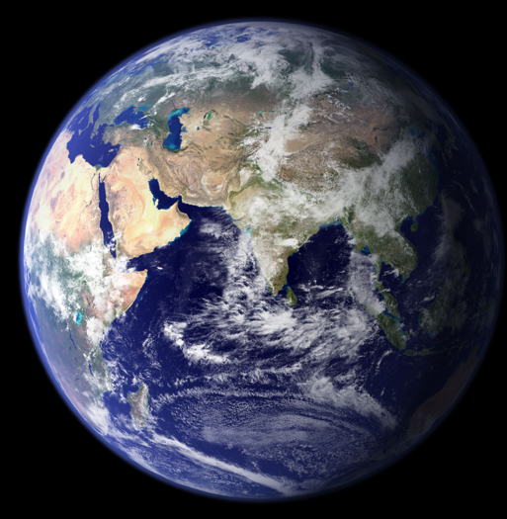
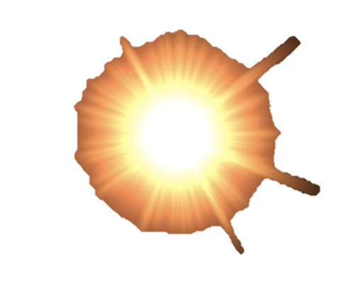
The Big questions - 1
Earth:
How is the global earth system changing?
How will the Earth system change in the future?
Heliophysics:
What causes the sun to vary?
How do the Earth and heliosphere respond?
What are the impacts on humanity?

Slide 6
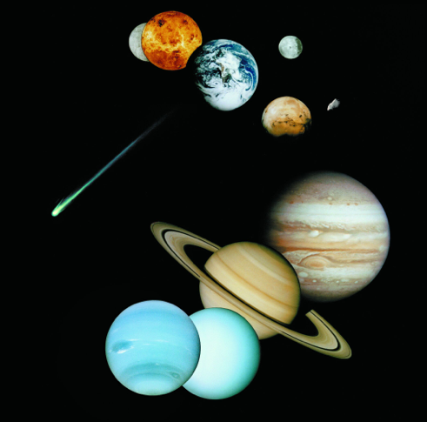
The Big Questions - 2
Planets:
How did the sun's family of planets and minor bodies originate?
How did the solar system evolve to its current diverse state?
How did life begin and evolve on Earth, and has it evolved elsewhere in the solar system?
What are the characteristics of the solar system that led to the origins of life?

Slide 7
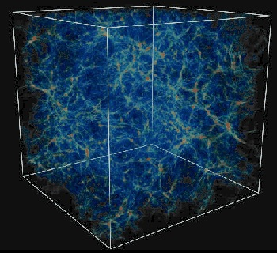
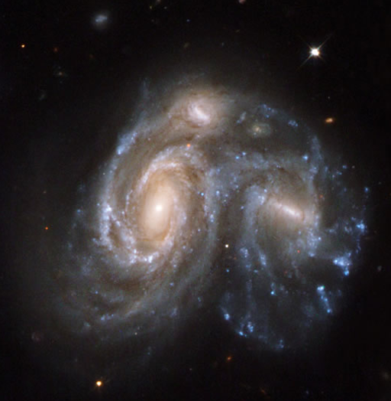
The big questions - 3
Astrophysics:
How do matter, energy, space, and time behave under the extraordinarily diverse conditions of the cosmos?
How did the universe originate and evolve to produce the galaxies, stars, and planets we see today?
What are the characteristics of planetary systems orbiting other stars, and do they harbor life?

Slide 8
Heliosphere
Notes:
Heliosphere model

Slide 9
The Heliosphere in a Kitchen Sink
Solar Wind - radial flow
Interstellar Space
Termination Shock
Heliosheath- flow turn toward drain
Heliopause- boundary of heliospheric bubble
4/30/2010-4
Notes:
From Dr Stone’s Voyager presentation

Slide 10
Heliophysics Missions
AIM – Ice composition in upper atmosphere.
CINDI – Dynamics of the ionosphere
SOHO – First Solar observatory
Solar Dynamics Observatory – Latest observatory to monitor heliosphere.
STEREO – Monitor and understand Coronal Mass Ejections
THEMIS – Study Earth’s magnetic field interaction with solar storms
IBEX / Voyager – Explore the Boundaries of the Solar System.
Notes:
Selected Heliophysics missions

Slide 11
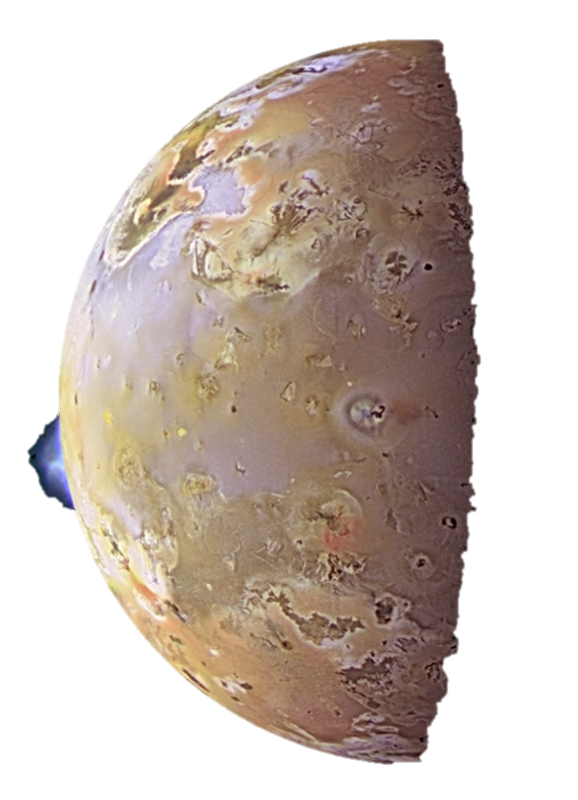
Exploring the Planets Do we have to go there?
View of Io from Hubble
View of Io from Galileo
Notes:
SMD Part 3: Exploring the planets. Why go there?

Slide 12
Exploring the Planets
Types of Missions
Fly by – Voyagers, New Horizons
Orbiter – Galileo, Magellan, Cassini, MESSENGER, MRO, LRO, Dawn
Probe – Huygens, Galileo, Deep Impact
Lander – Viking, Phoenix
Rover – Pathfinder, Spirit/Opportunity, Curiosity
Sample Return - StarDust
Notes:
Types of planetary missions

Slide 13
Exploring the Planets
Notes:
Exploration scorecard

Slide 14
CURRENT and Upcoming Missions
Lunar Reconnaissance Orbiter – launched June 18, 2009
Grail Lunar Orbiters – launched September 8, 2011
Mercury MESSENGER Orbiter – in orbit since March 2011
Juno Orbiter to Jupiter – launched August 5, 2011
Curiosity Rover (Mars Science Laboratory) – November 25, 2011
Notes:
High profile missions

Slide 15
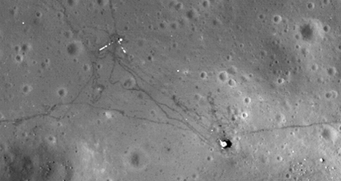
Manned Missions to the Moon
Lunar Reconnaissance Orbiter
Launched 2009
Orbiting at 24 km.
GRAIL
Twin orbiters to map Gravity
Launched Sept. 10, 2011
Apollo 12 landing site. Image by LRO

Slide 16
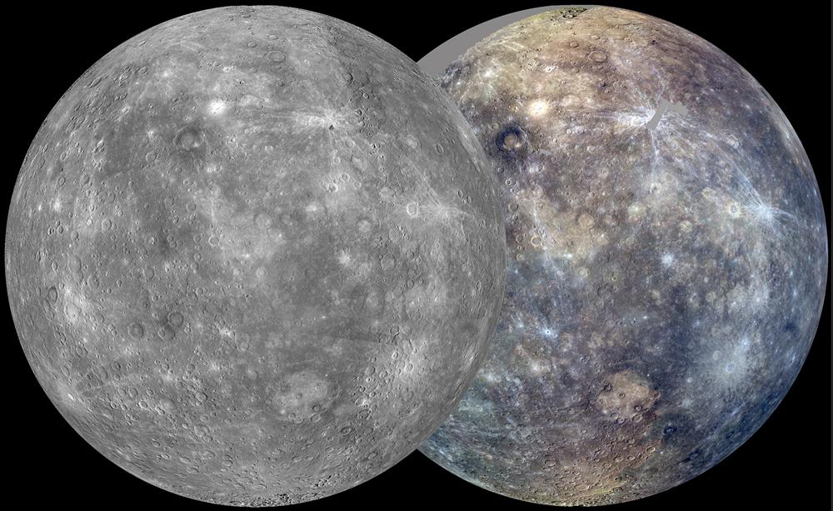
MESSENGER to Mercury
In orbit around Mercury since March 2011
Measuring magnetosphere, surface composition and environment.
Recent image shows composite image from first Solar Day
MESSENGER images
Notes:
Mercury

Slide 17
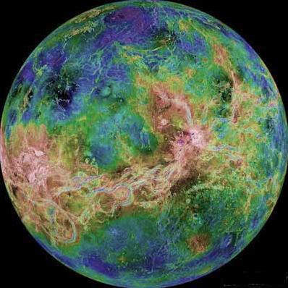
Venus
Magellan
Launch: May 4, 1989
This orbiter used imaging radar to map 99 percent of the surface of Venus over four years. After concluding its radar mapping, Magellan made global maps of Venus's gravity field. Flight controllers also tested a new maneuvering technique called aerobraking, which uses a planet's atmosphere to slow or steer a spacecraft.
Notes:
Not recent, but interesting.

Slide 18
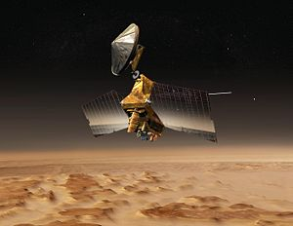
Mars
Mars Reconnaissance Orbiter
Launch: August 12, 2005
NASA's Mars Reconnaissance Orbiter has the most powerful telescopic camera ever sent to another planet, plus five other scientific instruments.
Phoenix
Launch: August 4, 2007
In the continuing pursuit of water on Mars, the poles are a good place to probe, as water ice is found there. This mission sent a high-latitude lander to Mars where it is using its robotic arm to dig trenches up to half a meter (1.6 feet) into layers of soil and water ice.
Curiosity Rover will launch in November 2011.
Notes:
Mars missions

Slide 19
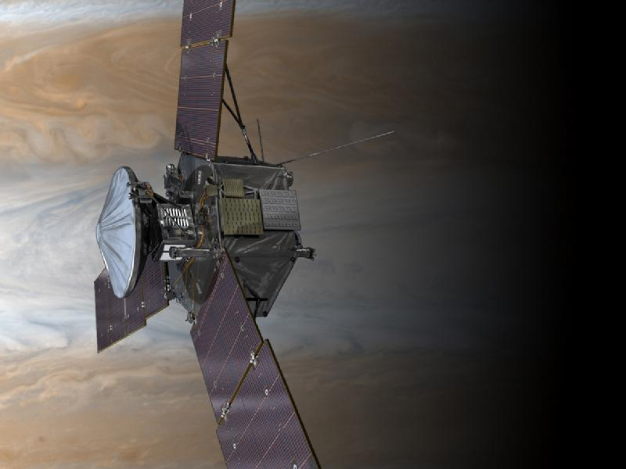
Jupiter
Galileo orbited from 1989 – 2003
Juno – launched August 5, 2011
Arrival at Jupiter in July 2016.
To study Jupiter’s origins and interior
Orbit to avoid intense radiation belts.
Notes:
Jupiter

Slide 20
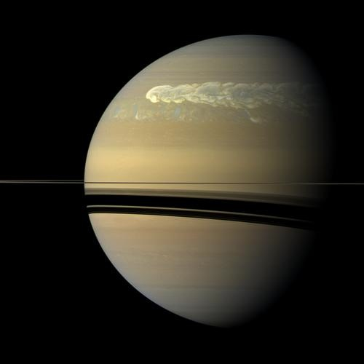
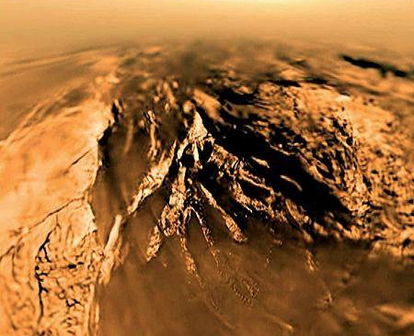
saturn
Cassini launched October 1997.
Arrived at Saturn in July 2004.
Huygens probe lands on Titan in 2005.
Saturn storm imaged by Cassini in 2010
Notes:
Saturn

Slide 21
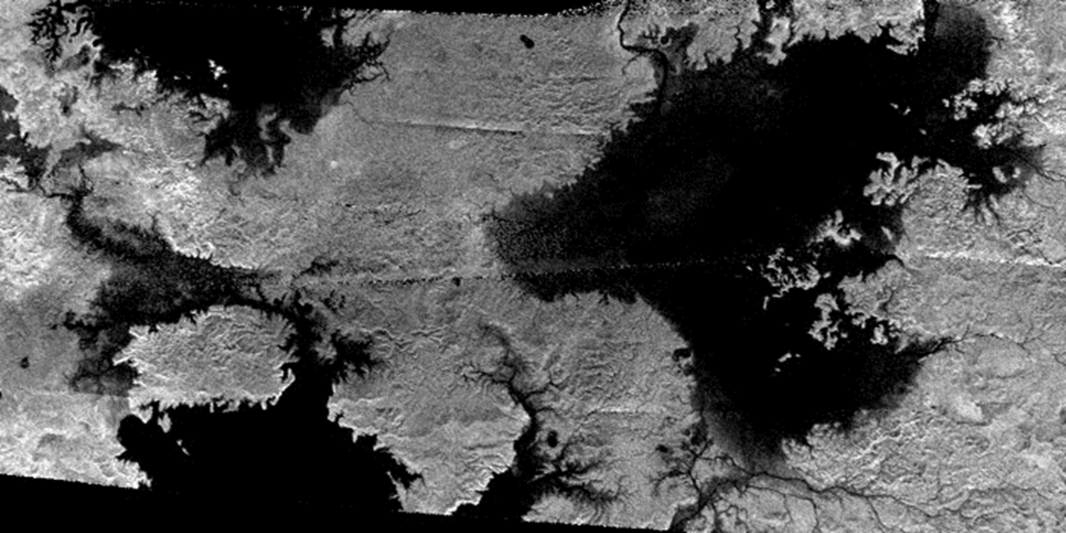
Titan
Titan found to have liquid methane which forms lakes and seas.
Methane weather cycle confirmed
Notes:
Titan has weather! Image show lakes, drainage patterns.

Slide 22
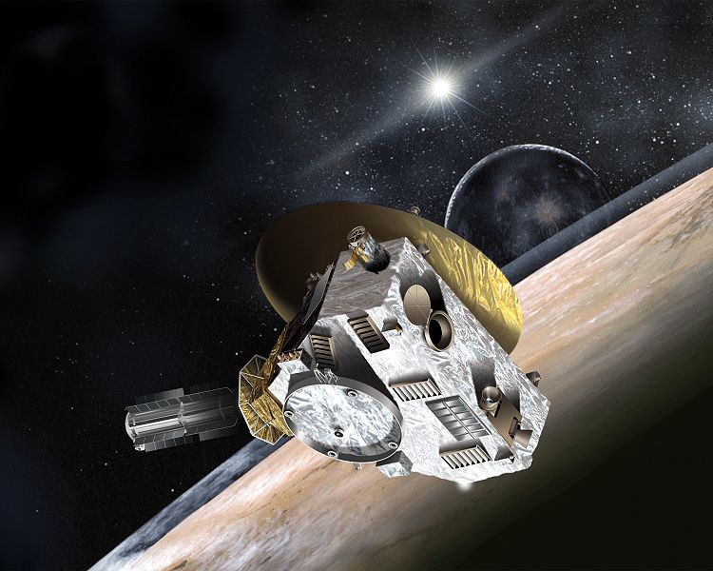
Pluto
New Horizon mission launched in 2005
Arrival at Pluto: July 14, 2015
Launched directly in solar system escape trajectory!
Notes:
Pluto and beyond.

Slide 23
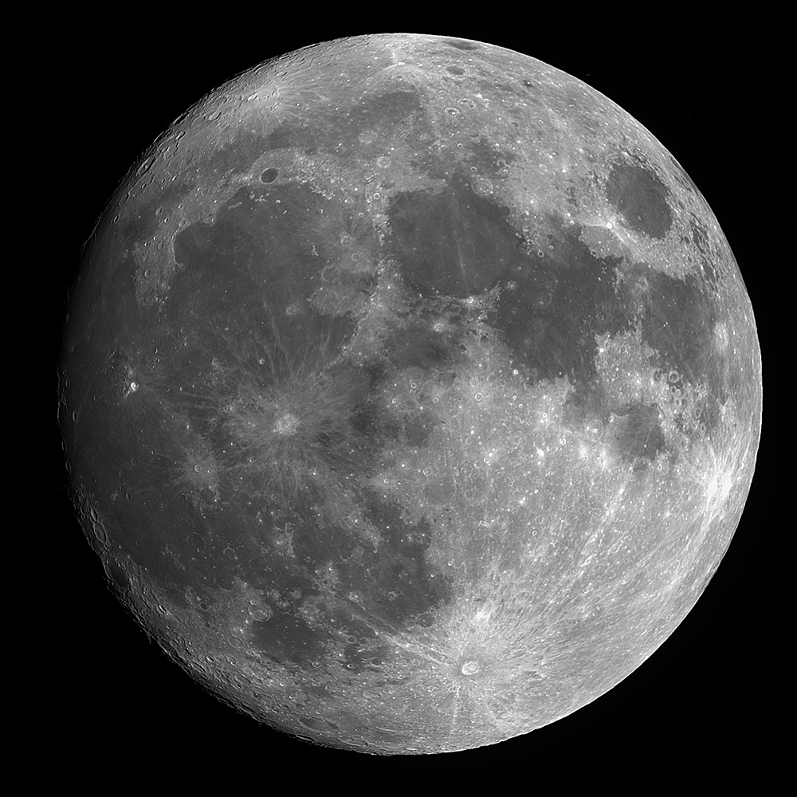
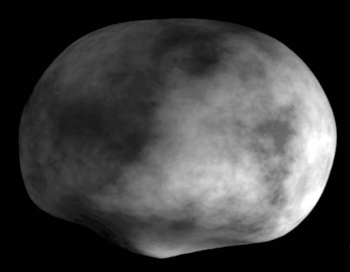
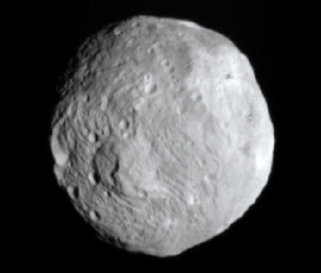
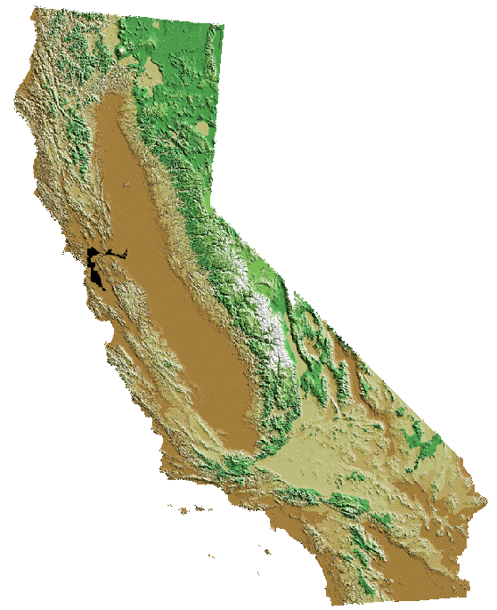
ASTEROIDS
Dawn Spacecraft
Ion Propulsion
Orbiting Vesta until 2012
Travelling on to Ceres
Vesta
Earth’s moon
Ceres
California
Notes:
Dawn at Vesta

Slide 24
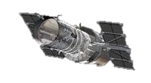
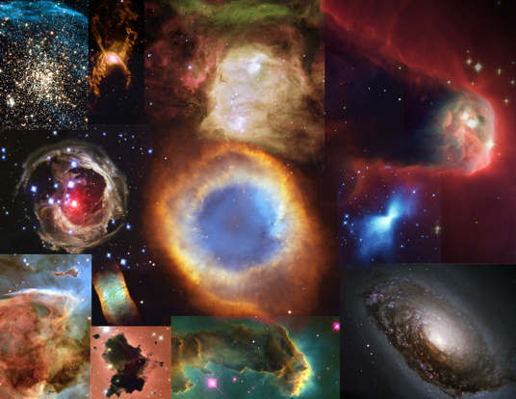
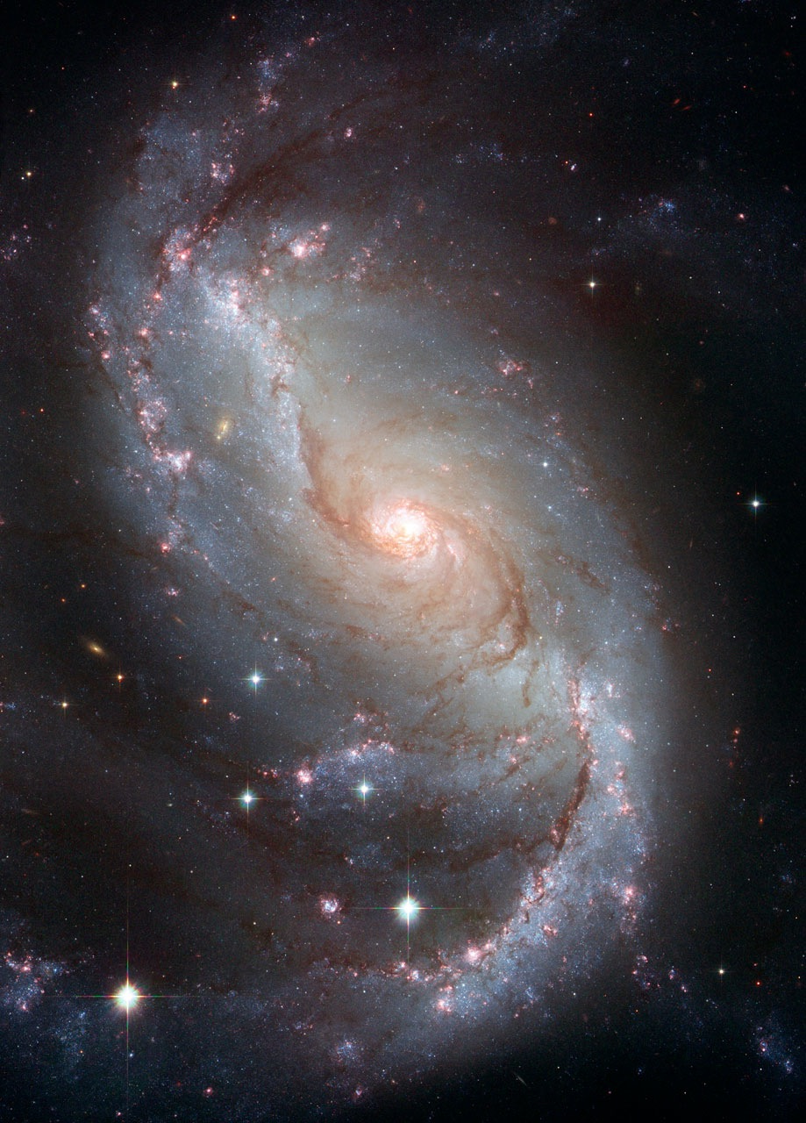
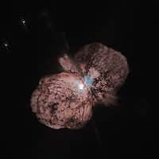
Hubble Space Telescope

Slide 25
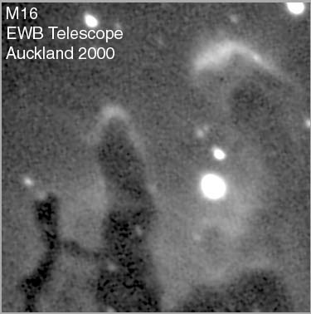
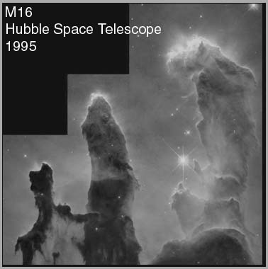
Space Exploration Telescopes in space
Photo from Auckland Observatory in New Zealand
Photo from Hubble Space Telescope
Notes:
Why we need satellites to explore deep space

Slide 26
Sensing the universe - missions
Compton - Great Gamma-ray Observatory – 1991 - 2000
Chandra – Great X-Ray Observatory – 1999
Fermi – Latest Gamma-ray observatory - 2008
GALEX – Origin and evolution of Galaxies - 2003
Herschel – far infrared telescope - 2009
Hubble Space Telescope – Great Optical Observatory – 1990 (+ 4 service missions)
Kepler – Looking for nearby planets – 2009
Planke – Cosmic Background Radiation observatory – 2009
Spitzer – Great Infrared Observatory – 2003
SWIFT – Gamma-ray burst explorer - 2004
Notes:
Selected Astrophysics missions

Slide 27
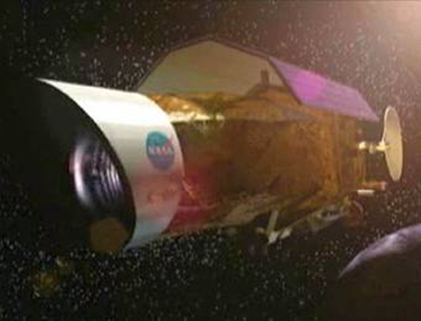
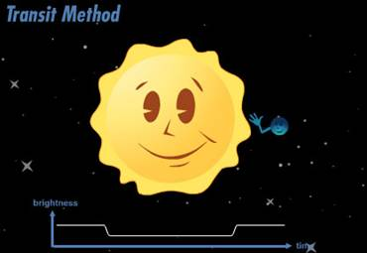
Looking for other earthS
Kepler - Launched March 6, 2009 to look for stars with planets.
Stare at stars and follow the light curves.
Over 1500 candidates found to date.
Notes:
Search for another Earth

Slide 28
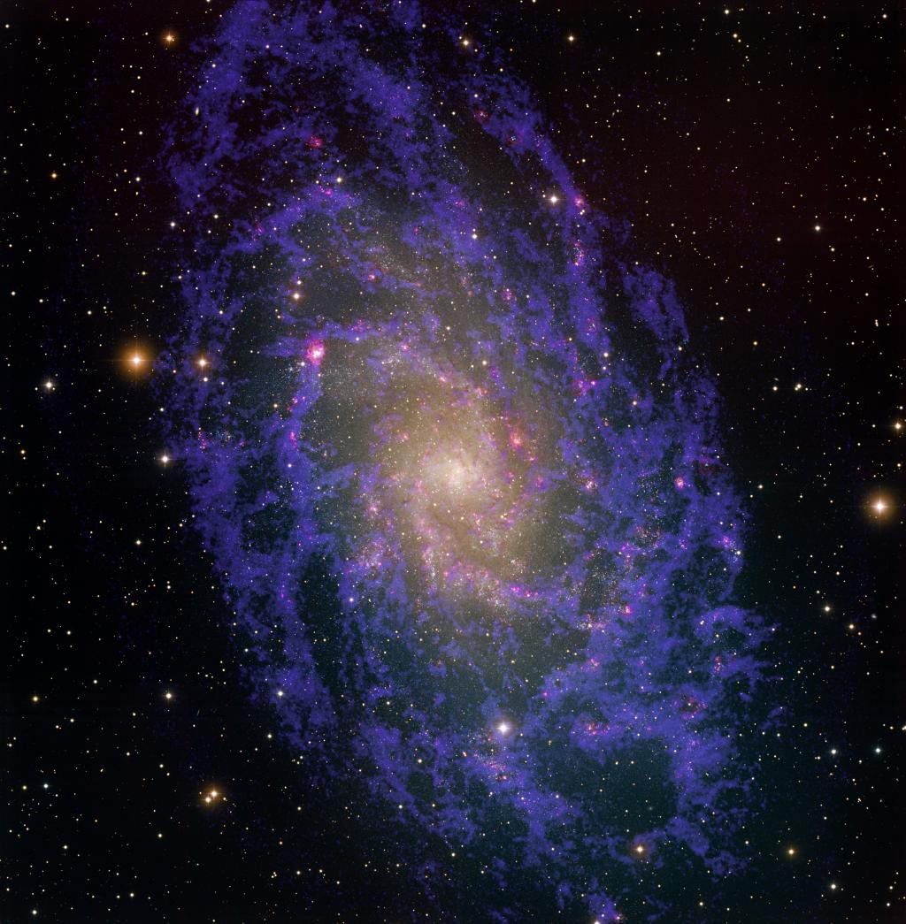
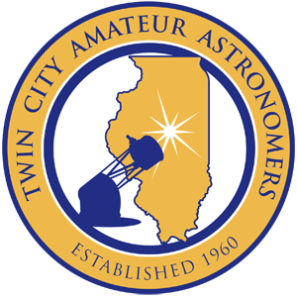
Twin City Amateur Astronomers
Sharing our love of astronomy for over 50 years!
http://tcaa.us
Notes:
Blatant plug about the local astronomy club.

Slide 29
Sugar Grove Observatory
Ground floor – storage and resting accommodations
Second floor – observing deck
Third floor – telescope dome

Slide 30
Our telescope and camera systems

Slide 31
Messier 101 and supernova, May/Aug

Slide 32
North American Nebula, August 3

Slide 33
Wizard Nebula, August 17

Slide 34
Comet garradd and messier 71, August 27

Slide 35
Pac man nebula, August 27-31

Slide 36
Tulip Nebula, September 2

Slide 37
Sharpless 171, September 14

Slide 38
M31 – Andromeda galaxy, October 2

Slide 39
M33 – Triangulum galaxy, October 2

